Slide 1
STOCK AND RECRUITMENT
Joseph T. DeAlteris
University of Rhode Island
Kingston, RI

Slide 2
Two-Stage Life History Model
F + M
RECRUITS ADULTS
RECRUITMENT

Slide 3
Application of S-R Relationships
Predict number of recruits at a future date based on estimates of present spawning stock abundance.
Rationale for regulating fishing mortality so as to avoid low stock sizes that may lead to recruitment failure and stock collapse.

Slide 4
Biological Processes Governing S-R Relationships
Density independent survival at low stock size.
Density dependent survival (compensation) at high stock size.

Slide 5
Spawning Stock is Measured by:
Number of females alive at each age times fecundity at age,
Number of individuals alive at each age times fecundity at age,
Total biomass of individuals at or above the age of first reproduction, or
Index of abundance of the population in the year eggs are deposited.

Slide 6
Recruitment is Measured by:
Recruits to the fishery determined by Virtual Population Analysis (VPA) from catch-at-age data and
Juvenile / pre-recruit surveys.

Slide 7
Basic Principles of the S-R Relationship (Ricker 1975)
The curve must start at the origin, that is at S(0), R(0).
At no point after S(0) will there be a R(0) (i.e. at high densities recruitment will not go to zero).
The rate of recruitment (R/S) should decrease continuously with increasing stock size; that is the highest rate of recruitment should be at the lowest stock level.
Recruitment must exceed parental stock size over some part of the range of S (when R and S are in the same units), otherwise stock collapse would result from any perturbation to the system.

Slide 8
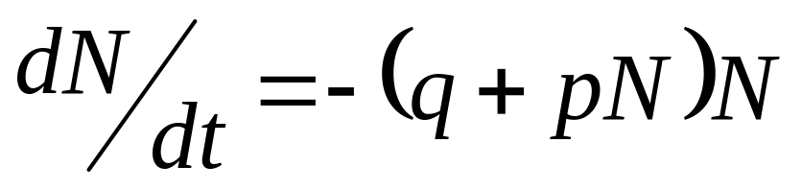
Basic Assumption of the Beverton-Holt Model (1957)
Where: N is the number alive in the cohort at time t,
q is a density-independent mortality rate, and
pN is a mortality rate component that is proportional to cohort size at time t.

Slide 9
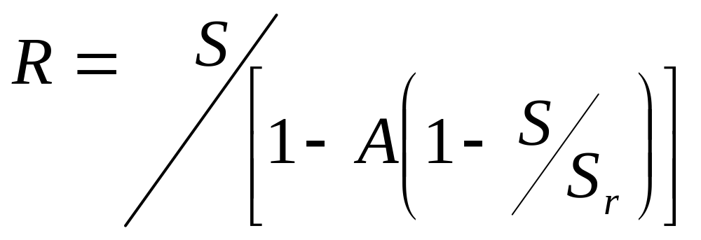
Beverton-Holt S-R Relationship (I)
Where: A is the shape of the curve and has values of 0 → 1
S and R are in the same units, and S = R at replacement (S_{r})

Slide 10
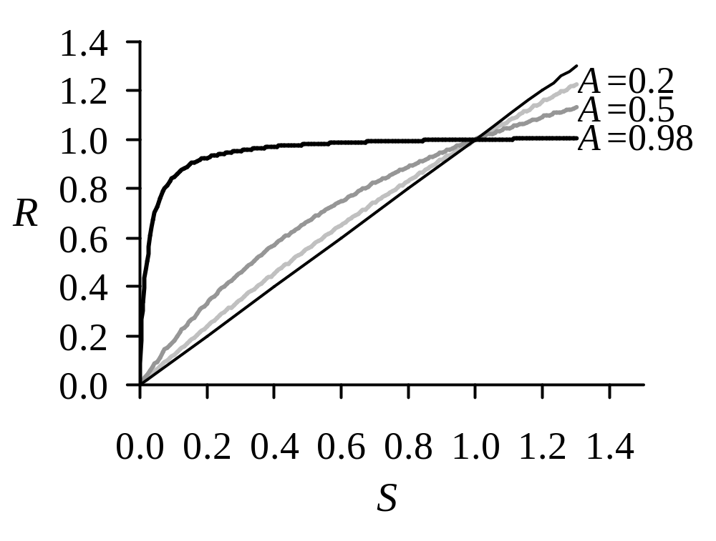
Beverton-Holt S-R Relationship with Changing Values of A
S = R
S_{r}

Slide 11
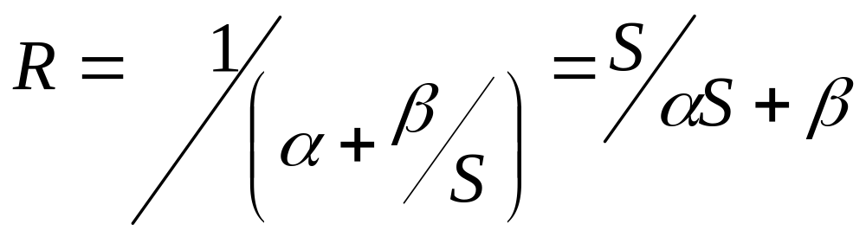
Beverton-Holt S-R Relationship (II)
Where: β = 1-A and
α = A/S_{r}
S and R are in different units
Note: as S → ∞, R = 1/α

Slide 12
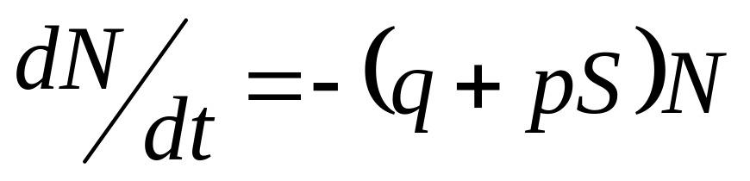
Basic Assumption of the Ricker Model (1954, 1975)
Where: N is the cohort size at any time t,
S is the initial spawning stock size,
q is the density independent mortality rate, and
pS is the mortality rate proportional to the initial stock size.

Slide 13
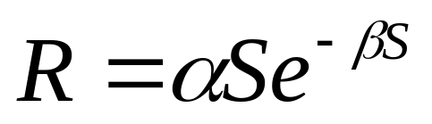
Ricker S-R Relationship
Where: α is the recruits per spawners (R/S, the slope) at low stock sizes, and
β is the shape of the curve

Slide 14
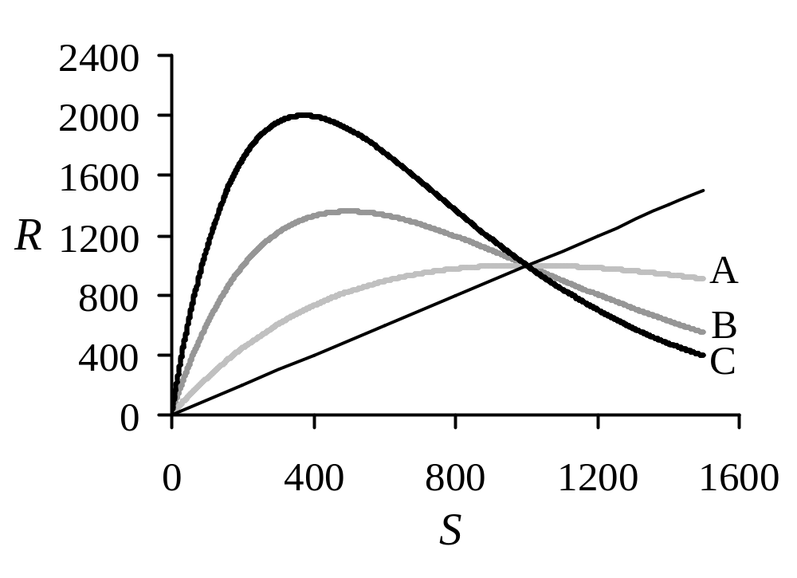
Ricker S-R Relationship at Various α and β Values
A: α = 2.718, β = 0.001
B: α = 7.389, β = 0.002
C: α = 14.556, β = 0.002678

Slide 15
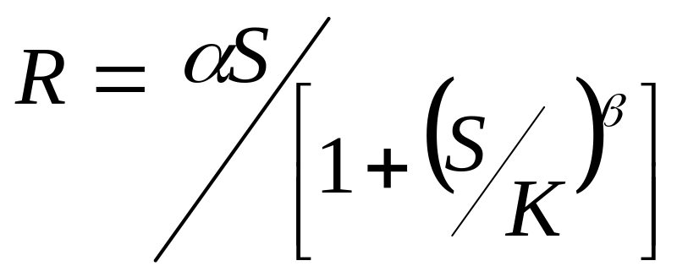
Shepard S-R Relationship
Where: α is the slope at the origin,
β describes the shape of the curve and provides for the degree of compensation, and
    K is the threshold stock biomass above which density dependent effects overcome density independent effects.

Slide 16
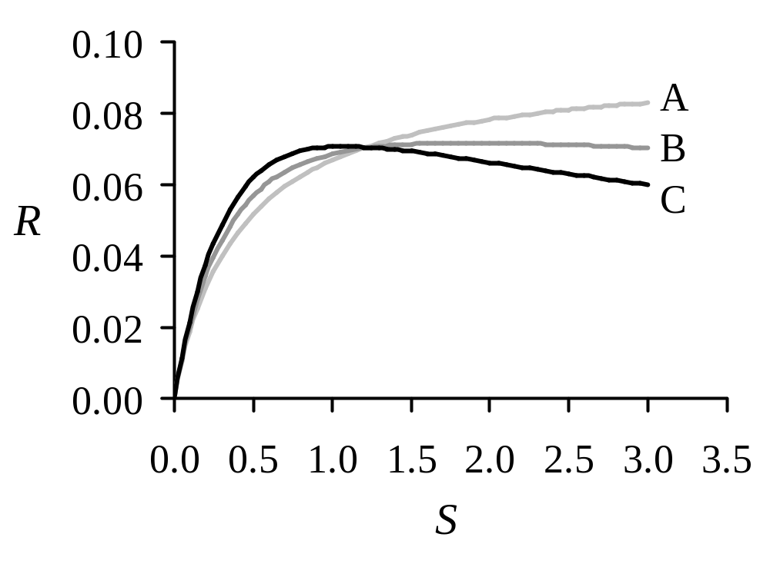
Shepard S-R Relationship at Various α, K, and β Values
A: α = 0.23, K = 0.41, β = 1.0
B: α = 0.23, K = 0.49, β = 1.2
C: α = 0.23, K = 0.56, β = 1.4

Slide 17
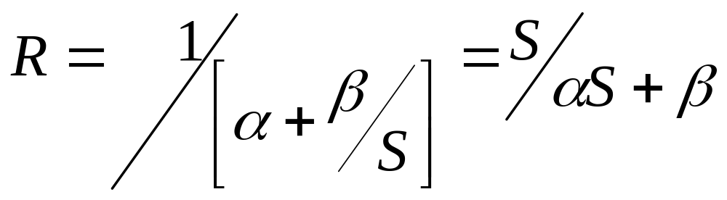
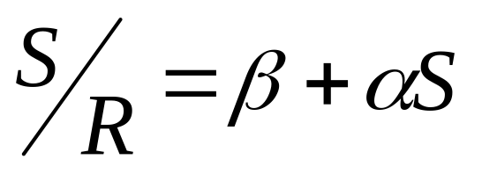
Estimation of S-R Parameters Using Beverton-Holt Model

Slide 18
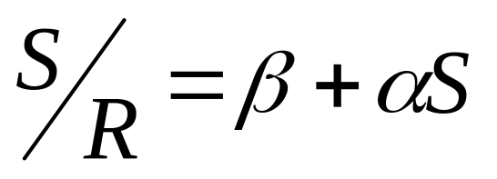
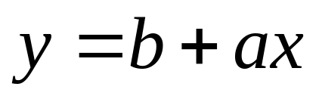
Linearized Beverton-Holt S-R Model
Where: y = S/R
a = slope = α
x = S
b = intercept = β

Slide 19
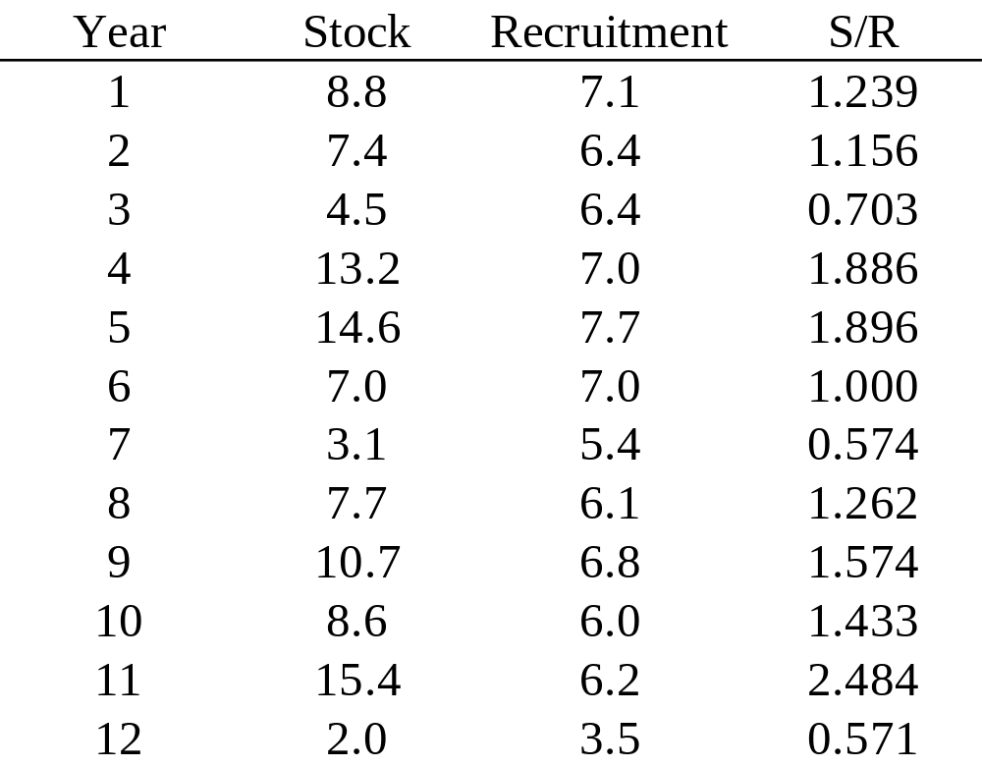
S-R Data

Slide 20
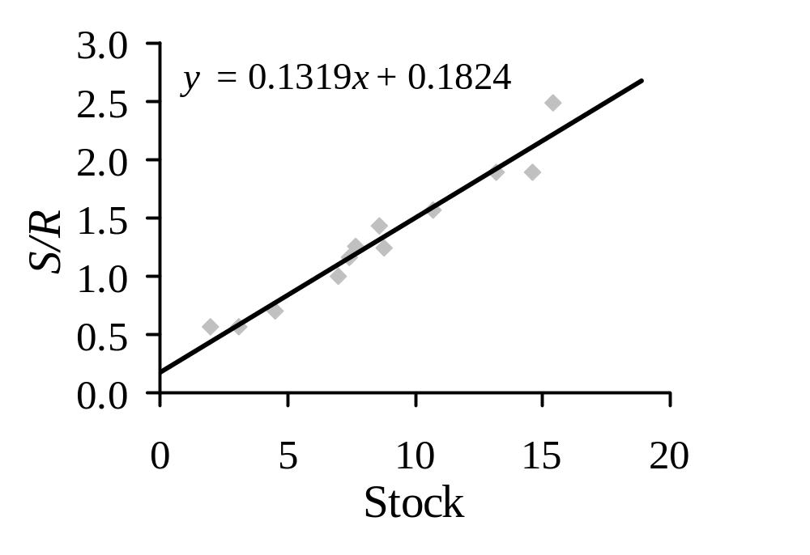
Application of S-R Data in the Linearized Beverton-Holt S-R Relationship
Linear Estimates
α = 0.1319
β = 0.1824

Slide 21
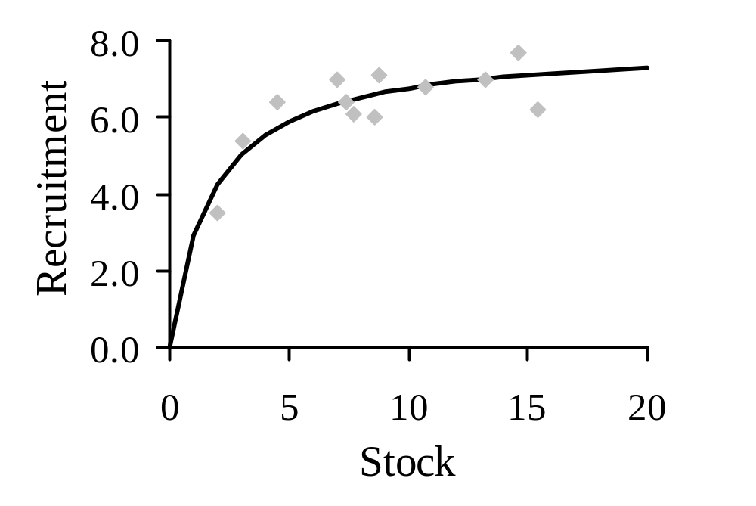
Application of S-R Data in the Non-linear Beverton-Holt S-R Relationship
Non-linear Estimates
α = 0.1262
β = 0.2167

Slide 22
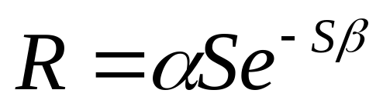
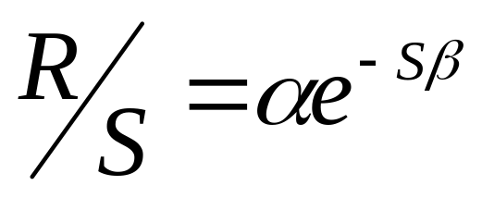
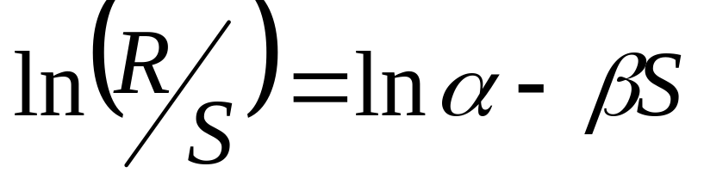
Estimation of S-R Parameters Using Ricker Model

Slide 23
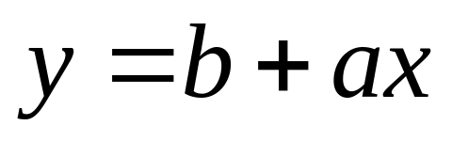
Linearized Ricker S-R Model
Where: y = ln(R/S)
a = slope = -β
x = S
b = intercept = lnα

Slide 24
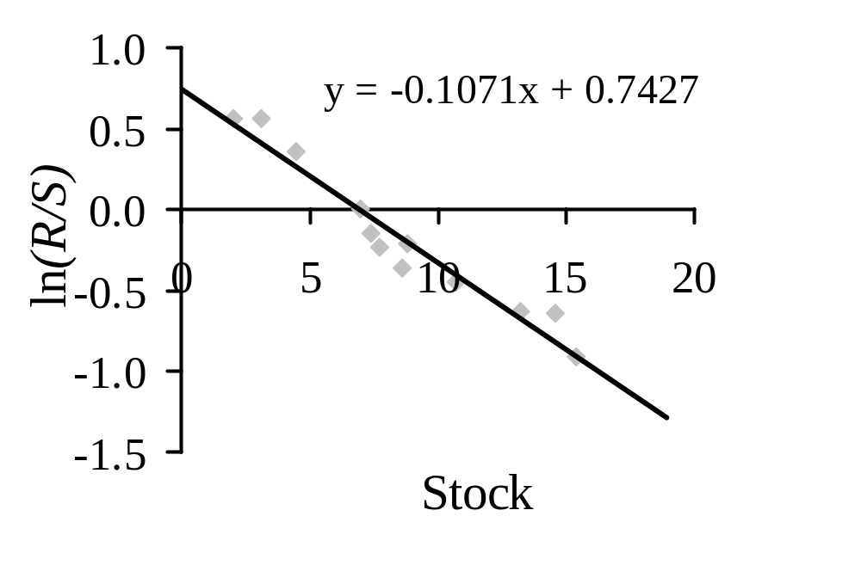
Application of S-R Data in the Linearized Ricker S-R Relationship
Linear Estimates
b = lnα
0.7427 = lnα
α = e^{0.7427} = 2.106
-a = β = 0.1071

Slide 25
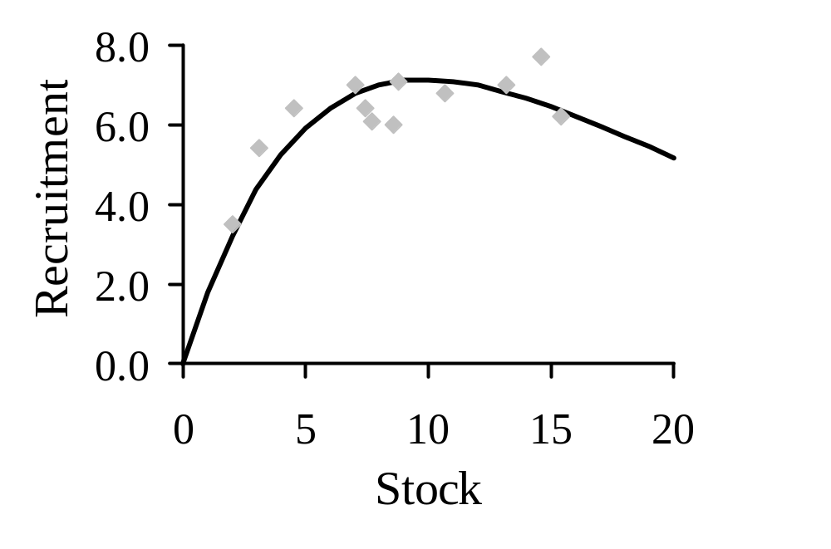
Application of S-R Data in the Non-linear Ricker S-R Relationship
Non-linear Estimates
α = 0.1262
β = 0.2167

Slide 26
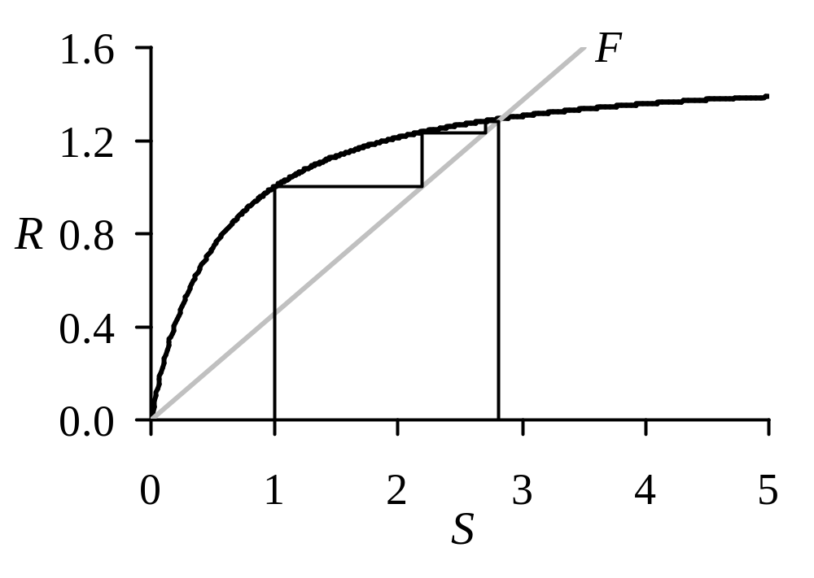
Two-Stage Life History Trajectory Based on the Intersection of S-R and SSBPR Relationships

Slide 27
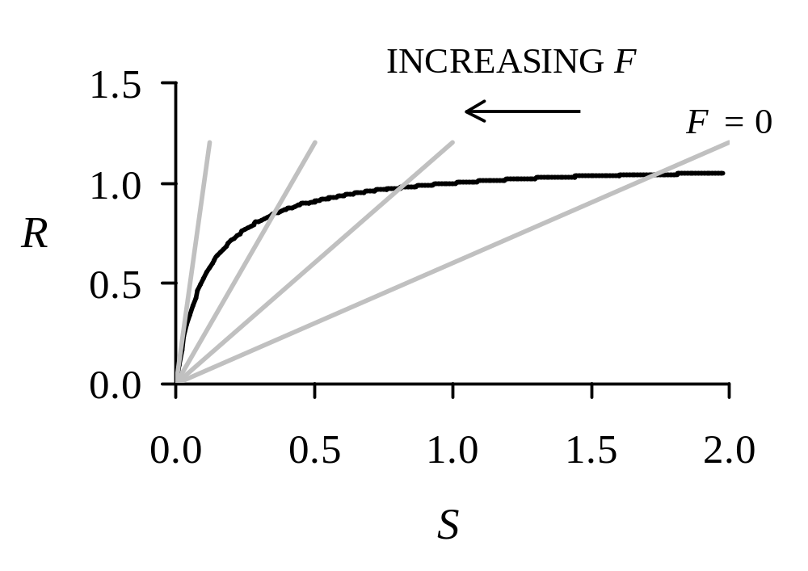
Intersection of SSBPR Functions at Various Fishing Mortality Levels (F) with a Beverton-Holt S-R Relationship

Slide 28
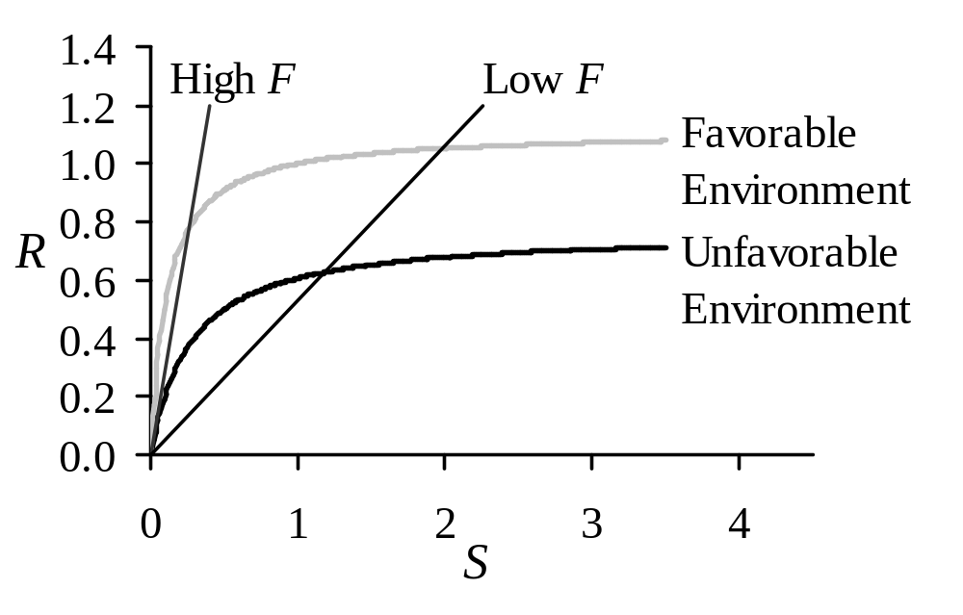
Effect of Environmental Suitability on the S-R and SSBPR Relationships

Slide 29
Examples of Stock-Recruitment Relationships from Fish Stock Assessments
      Blue Crab
      Shad
      others

Slide 30
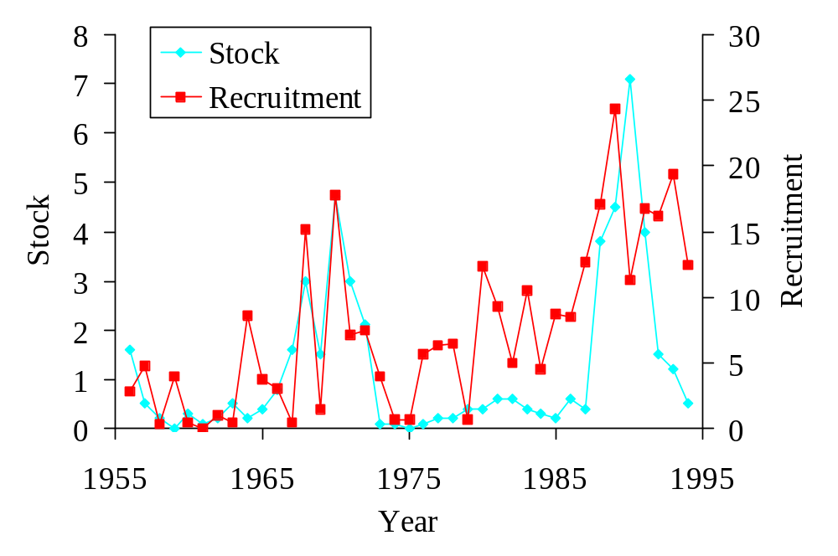
Blue Crab: Stock-Recruitment Time Series

Slide 31
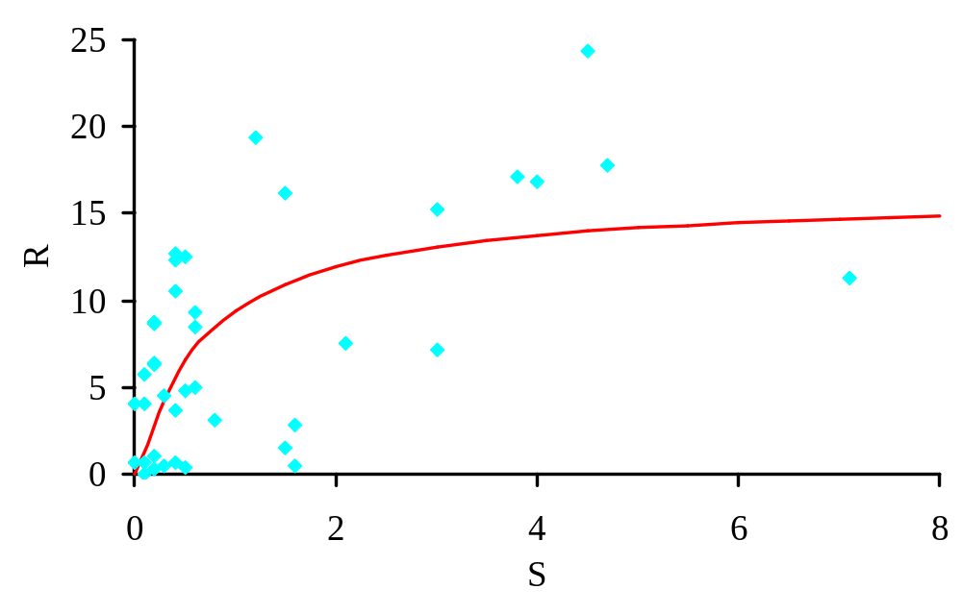
Blue Crab: Stock-Recruitment Relationships

Slide 32
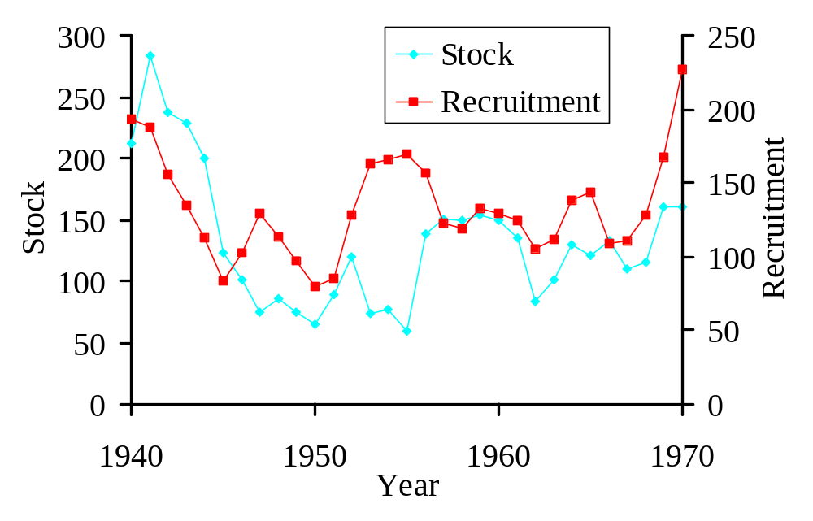
Shad: Stock-Recruitment Time Series

Slide 33
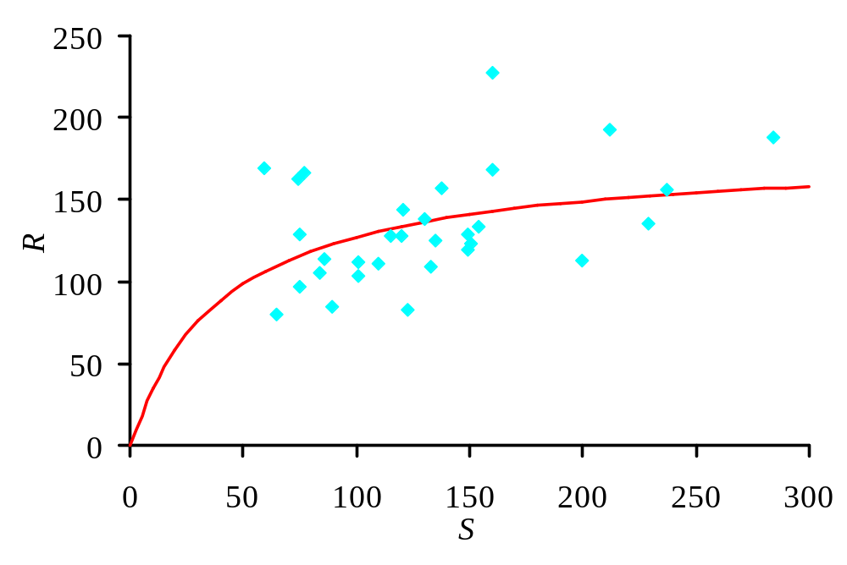
Shad: Stock-Recruitment Relationship

Slide 34
Summary: Stock-Recruitment Models
  Stock-recruitment relationships are often difficult to discern.
  Environmental factors have a substantial effect on recruitment success.
  Stock-recruitment reference points refer to the minimum stock level that produces sufficient recruitment to sustain a healthy stock

